Slide 1
Welcome to the Reception Curriculum meeting!
Notes:
1

Slide 2
Aims of the meeting
To help you to understand the curriculum that your child will be covering in the reception class.
To understand how we teach in order to cover the requirements of the curriculum.
To identify the key ways in which you can help your child at home and in school.
Notes:
Recent research evidence demonstrates that...
Consistency across home and school promotes achievements for young children
Family involvement in children’s learning has an influence on children’s happiness, achievement and learning
Parent/school partnership can improve children’s motivation, behaviour and self-esteem and language development
2

Slide 3
Teaching Assistant:
Mrs Bradley
Class teacher: Miss Adams
Notes:
3

Slide 4
What is the Early Years Foundation Stage?
The Early Years Foundation Stage (EYFS) is the stage of education for children from birth to the end of the Reception year.
It is based on the recognition that children learn best through play and active learning. It is a play-based curriculum.
Notes:
Already using the curriculum at Pre School
We build on it during the Reception year
4

Slide 5
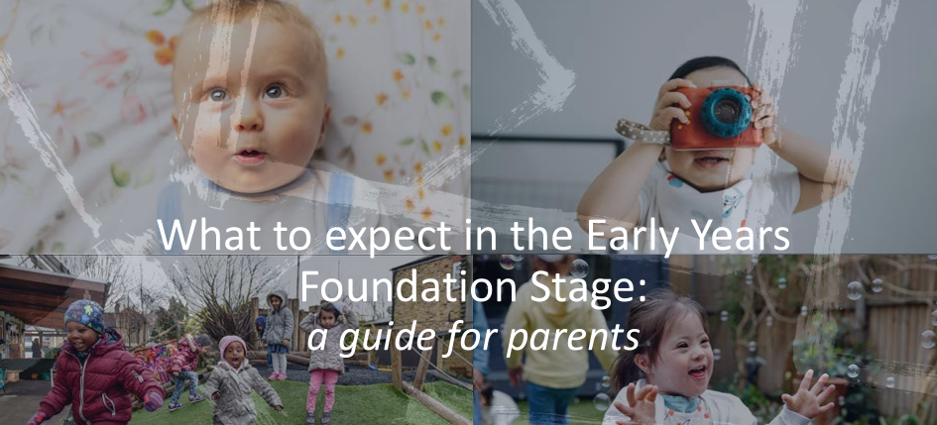
Parents’ Guide
https://www.foundationyears.org.uk/2021/09/updated-guidance-to-support-the-eyfs/

Slide 6
In the practice guidance it states:
“Play is essential for children’s development, building their confidence as they learn to explore, relate to others, set their own goals, and solve problems. Children learn by leading their own play, and by taking part in play and learning that is guided by adults. ” (p.17).

Slide 7
Something to think about!
“Adults who help children to play are adults who help children to learn.”
Bruce and Meggitt, 1999
Notes:
Early years specialists and authors

Slide 8

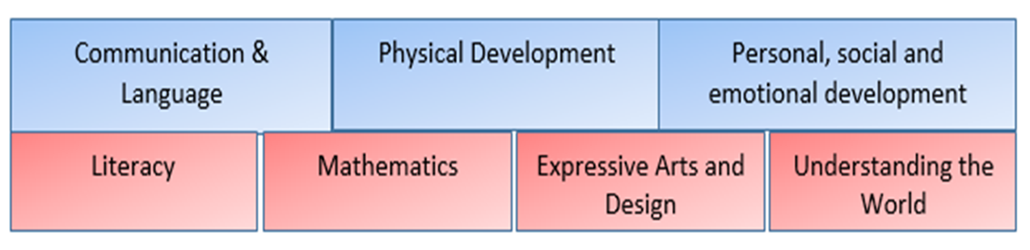
Three prime areas of learning and development
Communication and Language
Physical Development
Personal, Social and Emotional Development
Four specific areas of learning and development
Literacy
Mathematics
Understanding the World
Expressive Arts and Design
Notes:
Prime areas are a focus during first half of autumn term to enable the children to achieve in the specific areas.
If you can’t talk about it- you cant write about it
If you cant do large movements/ fine movements you cant hold a pencil
If you are worried/ anxious/ falling out with friends- not happy and secure to learn other things
8

Slide 9
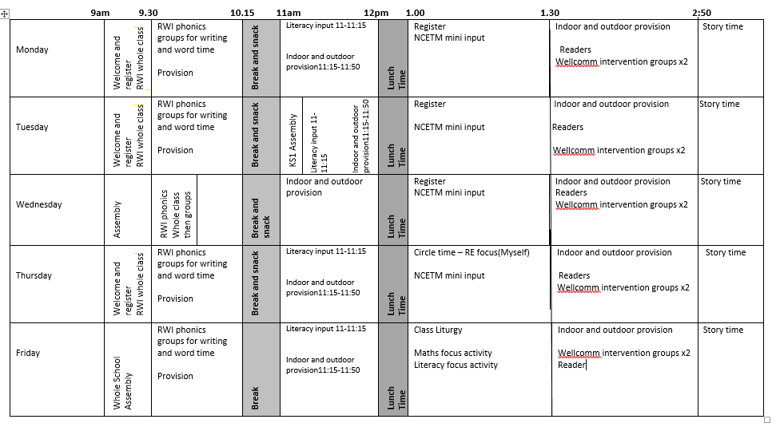
A typical school day

Slide 10
The first term
We will find out what the children
already know and can do
and use this information to help us understand the
next steps
for each child.
We spend lots of our time working and talking to the children about what they are learning. We may record some ‘Wow’ moments formally but largely we assess and move children on ‘in the moment’ and so not everything gets recorded.
Just started this year using books (maths and literacy) so we record our focus tasks in these books.
Notes:
10

Slide 11

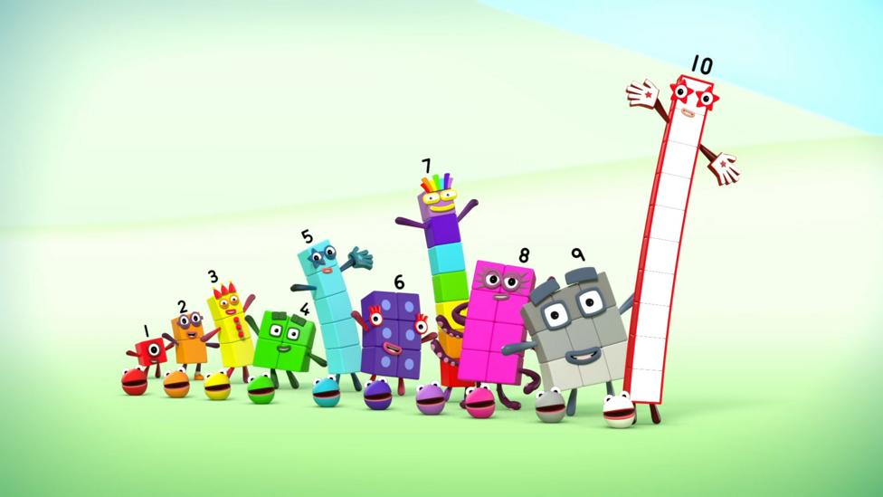
Maths
We use the ‘NCETM’ scheme.
The guidance documents are in line with the EYFS framework.
Supports delivery of a curriculum that is embeds mastering number.
Numberblocks are used to support this mastering of number.
Notes:
The first few years of a child’s life are especially important for mathematics development. Research shows that early mathematical knowledge predicts later reading ability and general education and social progress^{(ii)}. Conversely, children who start behind in mathematics tend to stay behind throughout their whole educational journey^{(iii)}.
Do they come up with their own ideas/ make links in their learning/ challenge themselves/ persevere/ make predictions and test them out etc.
11

Slide 12
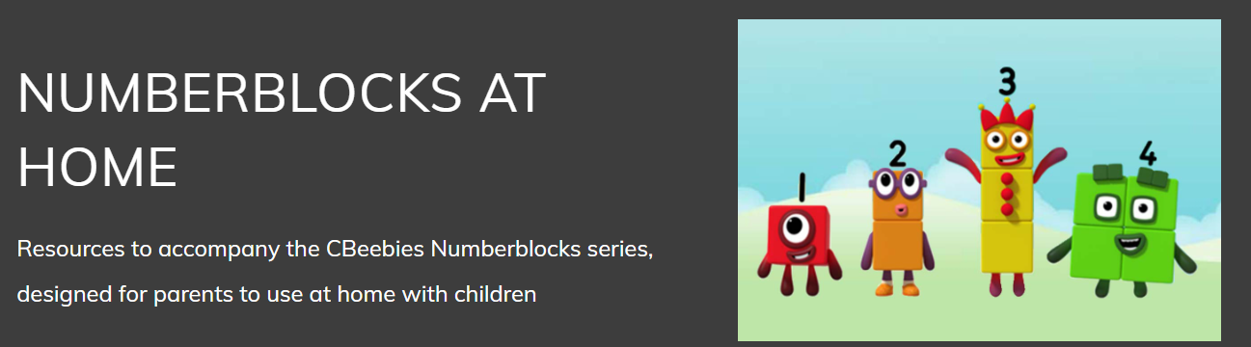
Access the NCETM home learning videos

Slide 13
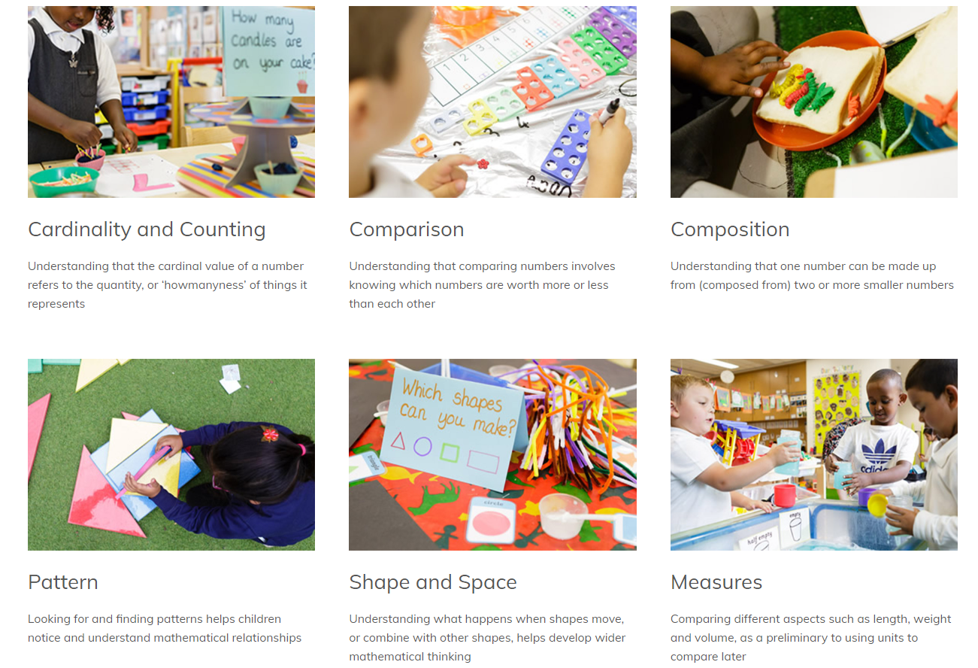
Notes:
The guidance has been split in to 6 phases and provides opportunities to develop the understanding of number, shape, measure and space.

Slide 14
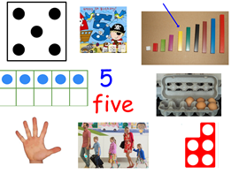
It is important that children develop a really strong sense of numbers to 10.
Notes:
14

Slide 15
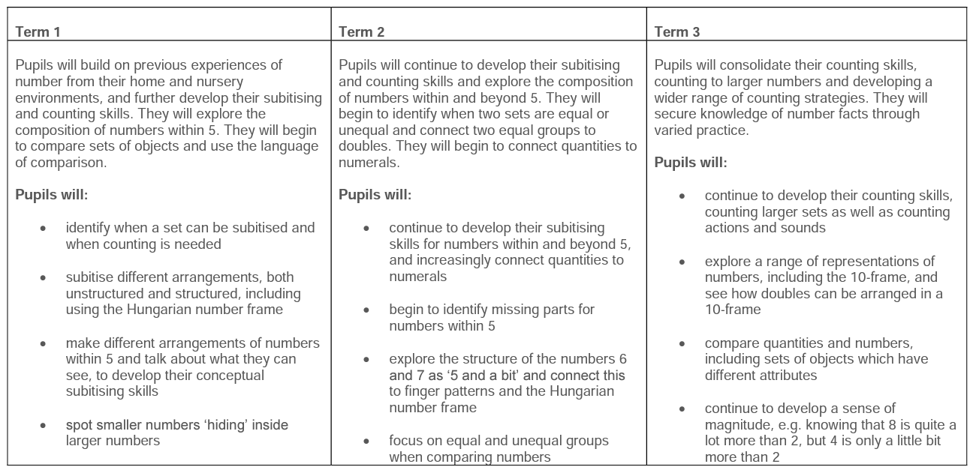
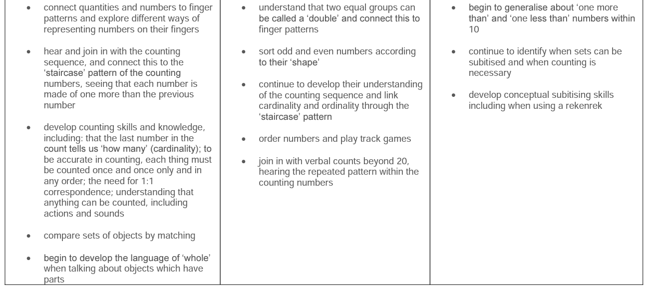

Slide 16
Reading for pleasure
We love to read in Reception class!
“If you read just one book a day to your child, they will have been read 1825 books by their 5th birthday!”
Notes:
The children’s day is balanced between adult focused activities and independent learning time where the children have the choice what they do. They are encouraged to become independent learners- eg find their resources and put them away at the end.
We use both inside and outside daily.
This is also changeable throughout the year- once the children are settled we move to doing phonics first thing and have a maths slot etc
16

Slide 17

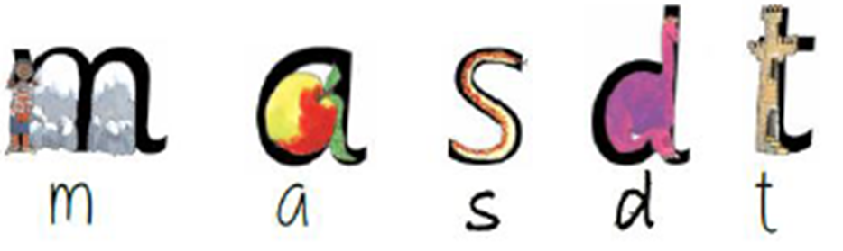
How do we teach reading?
We teach the letter sounds. This is known as ‘phonics’
‘Read Write Inc’ is the programme we use to support the delivery of phonics.
The children will learn the first 5 letter sounds initially.
Notes:
17

Slide 18
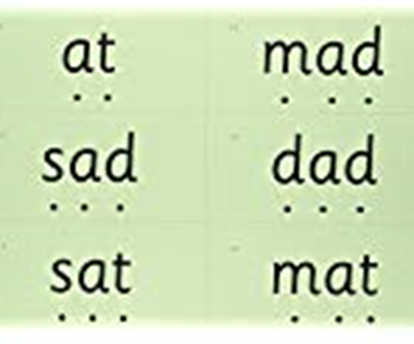

Blending the sounds together (Fred-talking)
Help from home!
Once the children are familiar with and can say the first 5 sounds;
m a s d t
The children then learn to blend the sounds together to read words. The children will know this as ‘Fred Talk’
Notes:
18

Slide 19
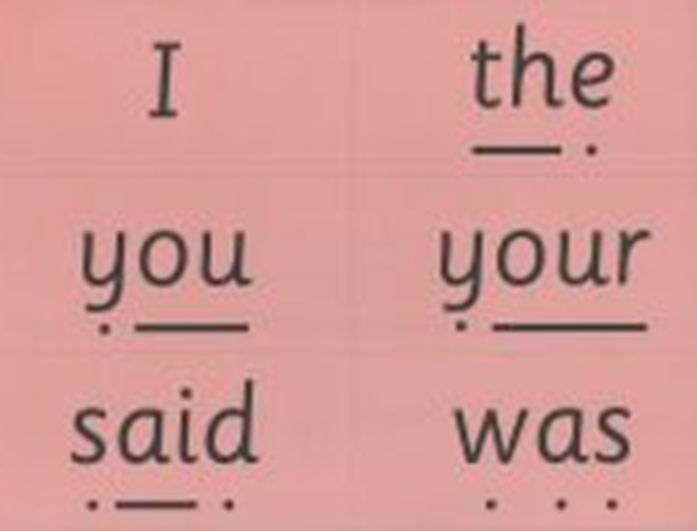
‘Red’ words
Some words have to be learned on sight because we cannot ‘sound them out’ (Fred talk)
We call these ‘tricky words’ or ‘red words’
“When it’s red, we can’t use Fred”
Notes:
19

Slide 20
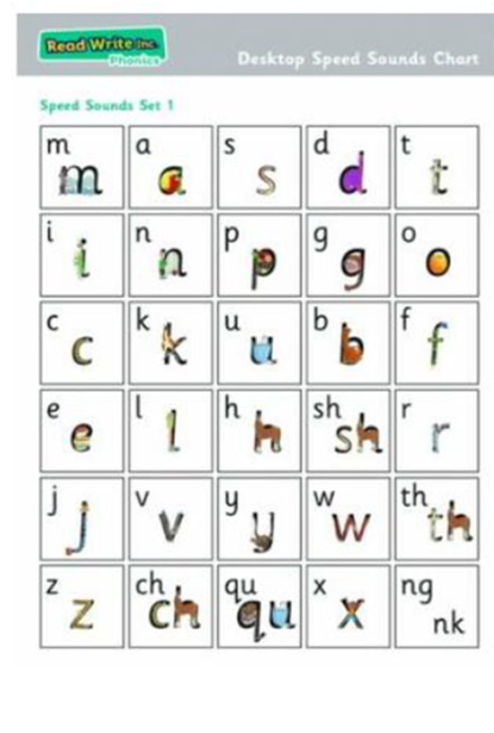
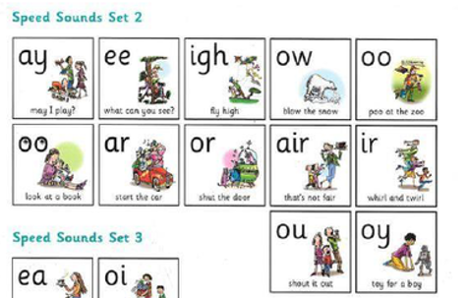
Expectation –
End of Autumn term – read all set 1 sounds, blend sounds into words orally
End of Spring 1 – blend sounds to read words, read short ditty stories

Slide 21
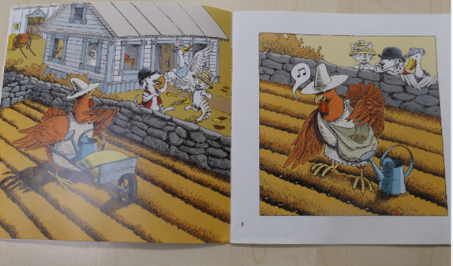

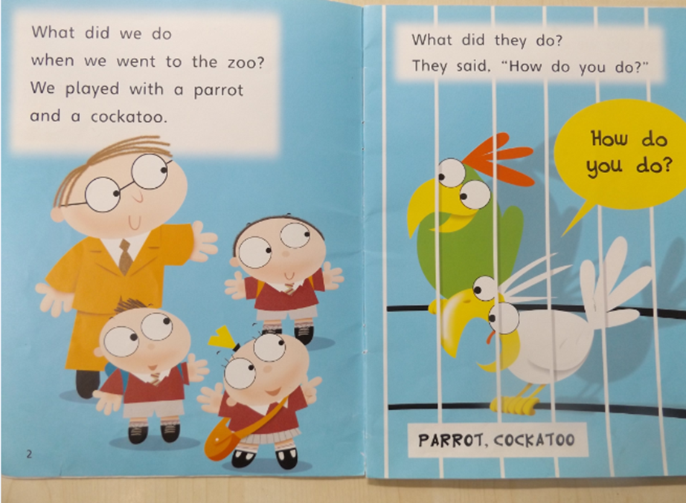
Reading expectation
abc books
Yellow level
Lilac level – wordless books
Pink level
Red level
Blue level
Notes:
read from a range of storybooks matched to their phonic knowledge ​
work with partners ​
develop comprehension skills in stories by answering 'Find It' and 'Prove It' discussion questions ​
21

Slide 22

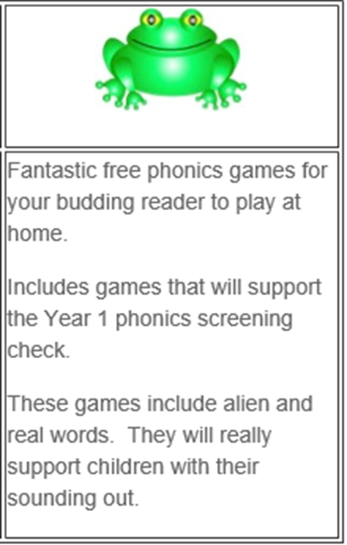
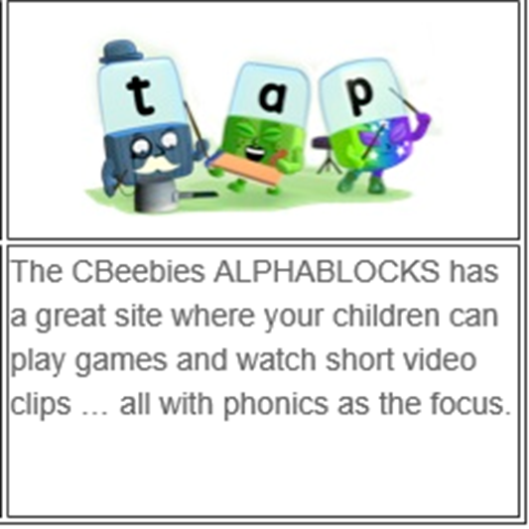
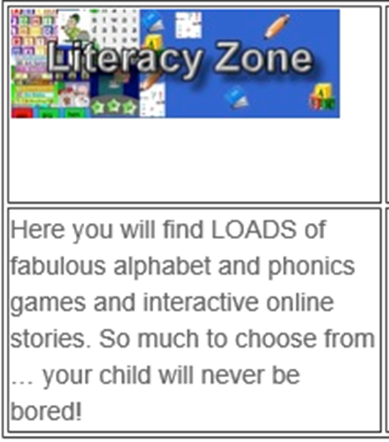
Home Learning
Talk, talk and more talk!
Share your child’s reading book at home every day
Sign the reading communication diary each time you read
Keep a look out for teacher comments
Cbeebies ALPHABLOCKS
Literacy Zone
Phonics Play
Oxford Owl
Notes:
22

Slide 23
How can I support my child’s reading and writing?​
​
One of the most important things you can do as a parent at home is read to your child. ​
Loving stories is important because children who love stories want to read stories for themselves. Children who read a lot become better readers.​
​
Ask your child to read the Speed Sound speedily​
Use Fred Talk to help your child read and spell words ​
Listen to your child read their book every day ​
Practise reading Red Words (common exception words) speedily​
Read stories to your child every day.​
​
Read the same book again and again ​
​
Children love reading the same book again and again. Their reading becomes speedier and they understand what they are reading.​
​
Encourage your child to read words using ‘Fred in your head’ ​
Show your child how to read the story in a storyteller voice​
Share your enjoyment of the story when they read it again and again.

Slide 24
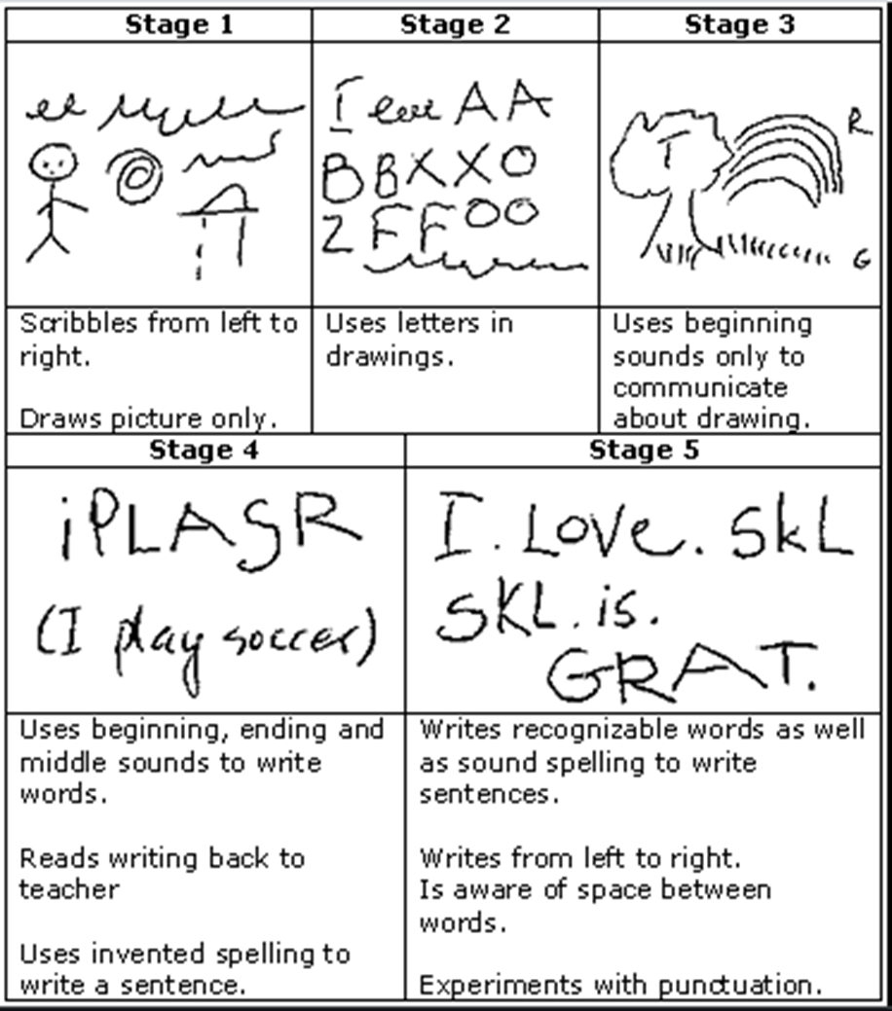
Early mark making/writing
When children are able to read words, they will begin to transfer the skills to writing.
Stages of writing -
Notes:
Writing​
The children:​
learn to write and form the letters/letter groups which represent the 44 sounds with the help of fun phrases ​
learn to write words by using Fred fingers​
learn to build sentences by practising sentences out loud before they write ​
24

Slide 25
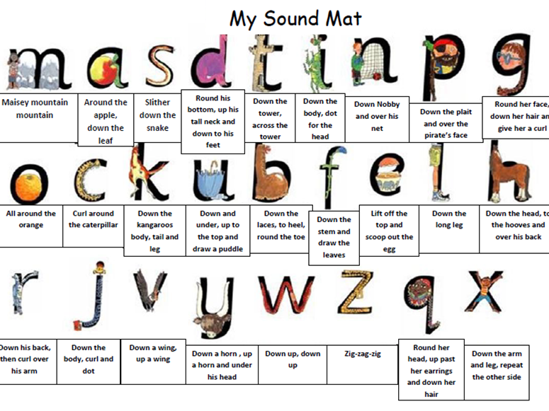

Slide 26
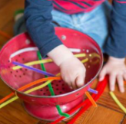
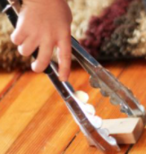
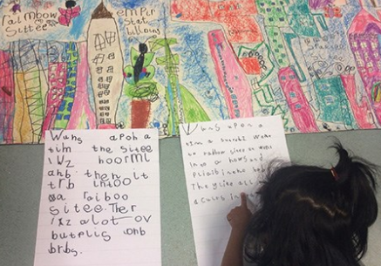
Home Learning
Fine motor activities (get ready to write!)
-Threading
-Cutting
-Manipulating playdough/slime
-Getting dressed with belts, buttons and zips
-Using cutlery
-Drawing in sand, foam or paint
Purposeful writing activities
-Writing a shopping list
-Writing a birthday card
-Writing a menu
Notes:
26

Slide 27
How can I help my child to practise their handwriting?​
Remind your child:​
To hold their pencil in ‘perfect pencil grip’ ‘pinchy parrot’​
Say the handwriting phrase to help them form the letter correctly – see Handwriting Phrases on https://www.ruthmiskin.com/en/find-out-more/parents/​
Challenge your child to see how many sounds they can write in a minute. ​
Say the sound and children write e.g. ‘write m’, ‘write s’, ‘write w’.​
​
How can I help my child to spell words?​
​
Encourage your child to use Fred Fingers to spell words​
Ask your child to say the sounds in the word as they press the sounds onto their fingers​
Ask your child to then write the letters – if they get stuck, say the sounds again​
Dictate a sentence including the word and ask your child to write the whole sentence​
​

Slide 28
Reminders
Wellies
Label all uniform
Water bottles
Bring in children’s book bags on their reading day – stuck on front of reading diary.

Slide 29

Let’s work together to give our children the chance they deserve.
Thank you for joining us today.
Notes:
29

